Slide 1
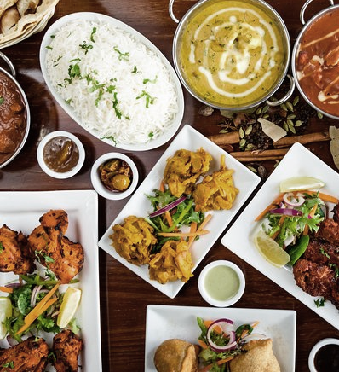

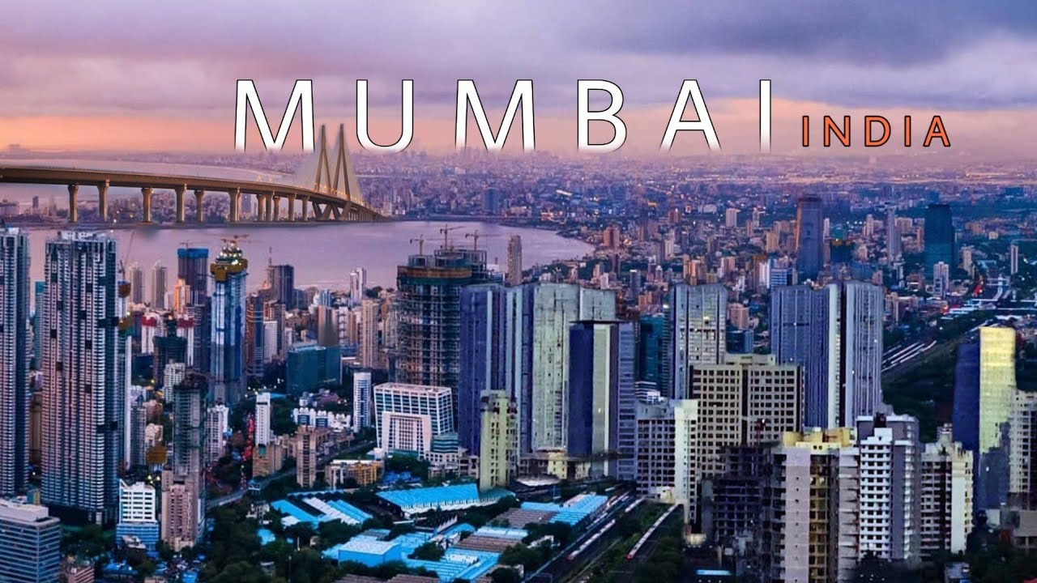
Mumbai Restaurant Recommendation
By: Wayne Untu
Dedicated for: FnB Businessmen or Investors who are interested to grab the Indian tourists, especially in Indonesia as a market segment by creating startup or franchise

Slide 2
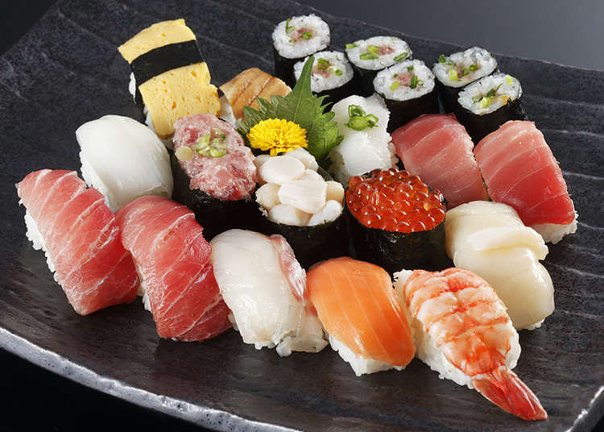
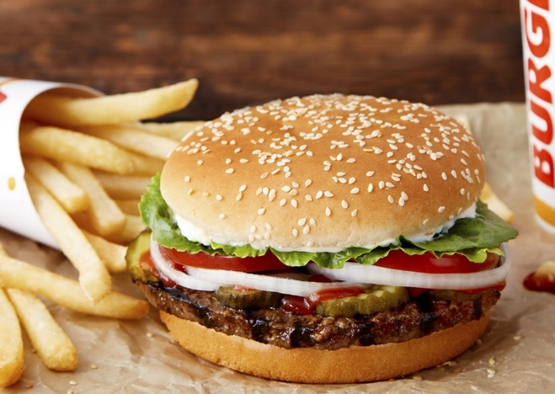
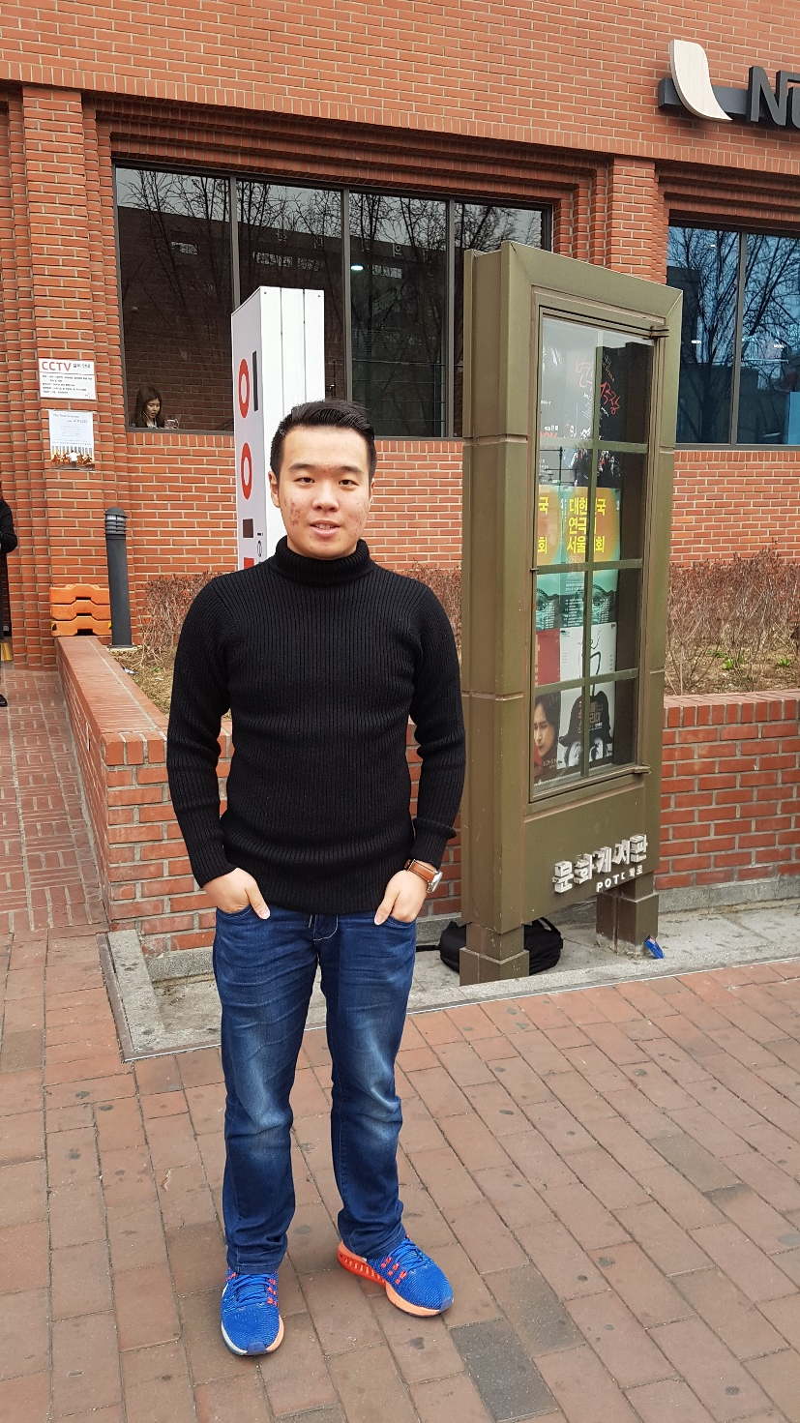
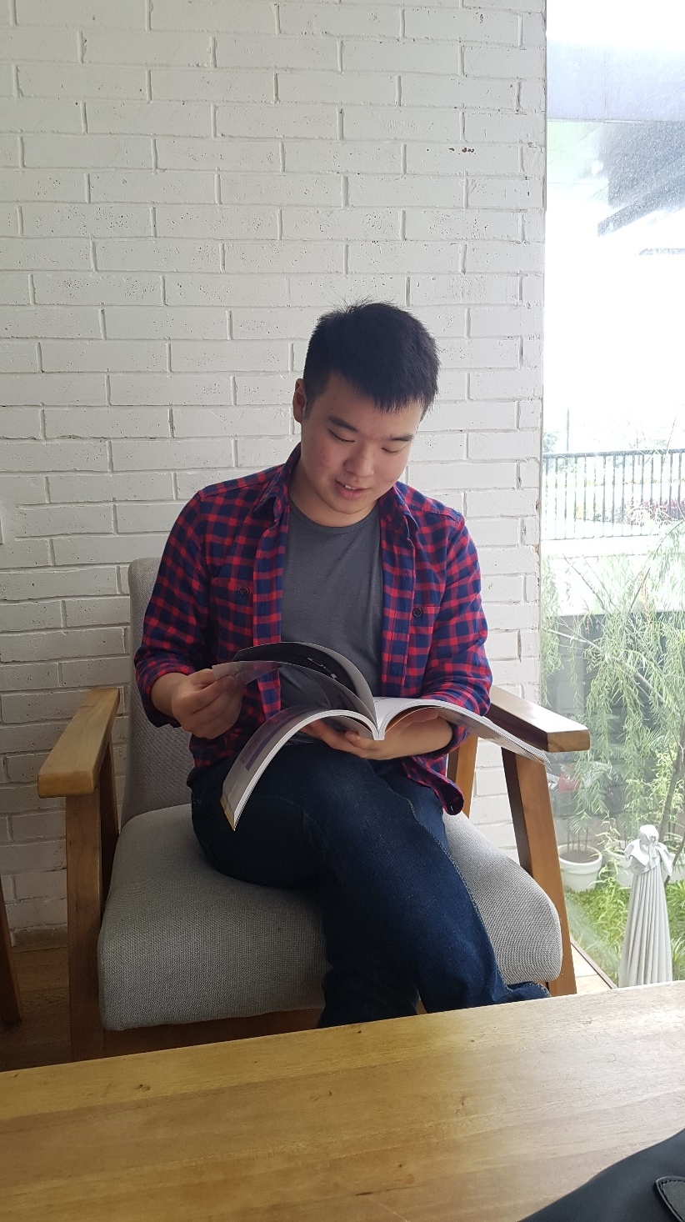
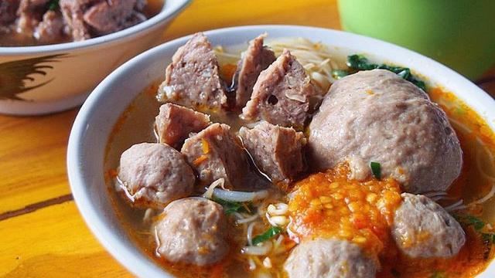
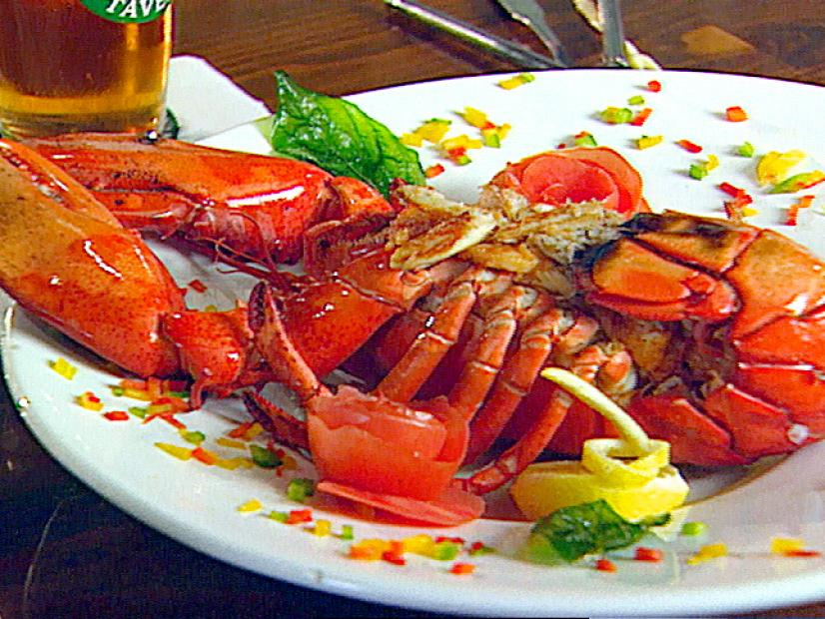
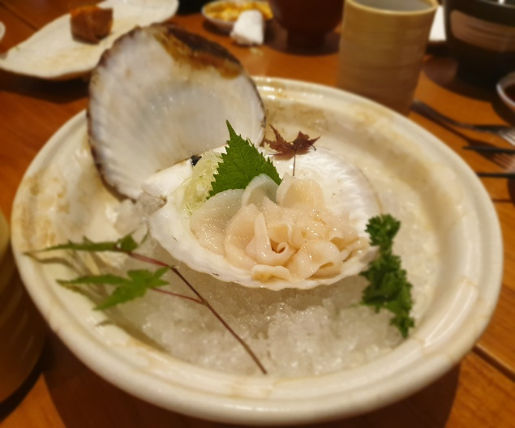
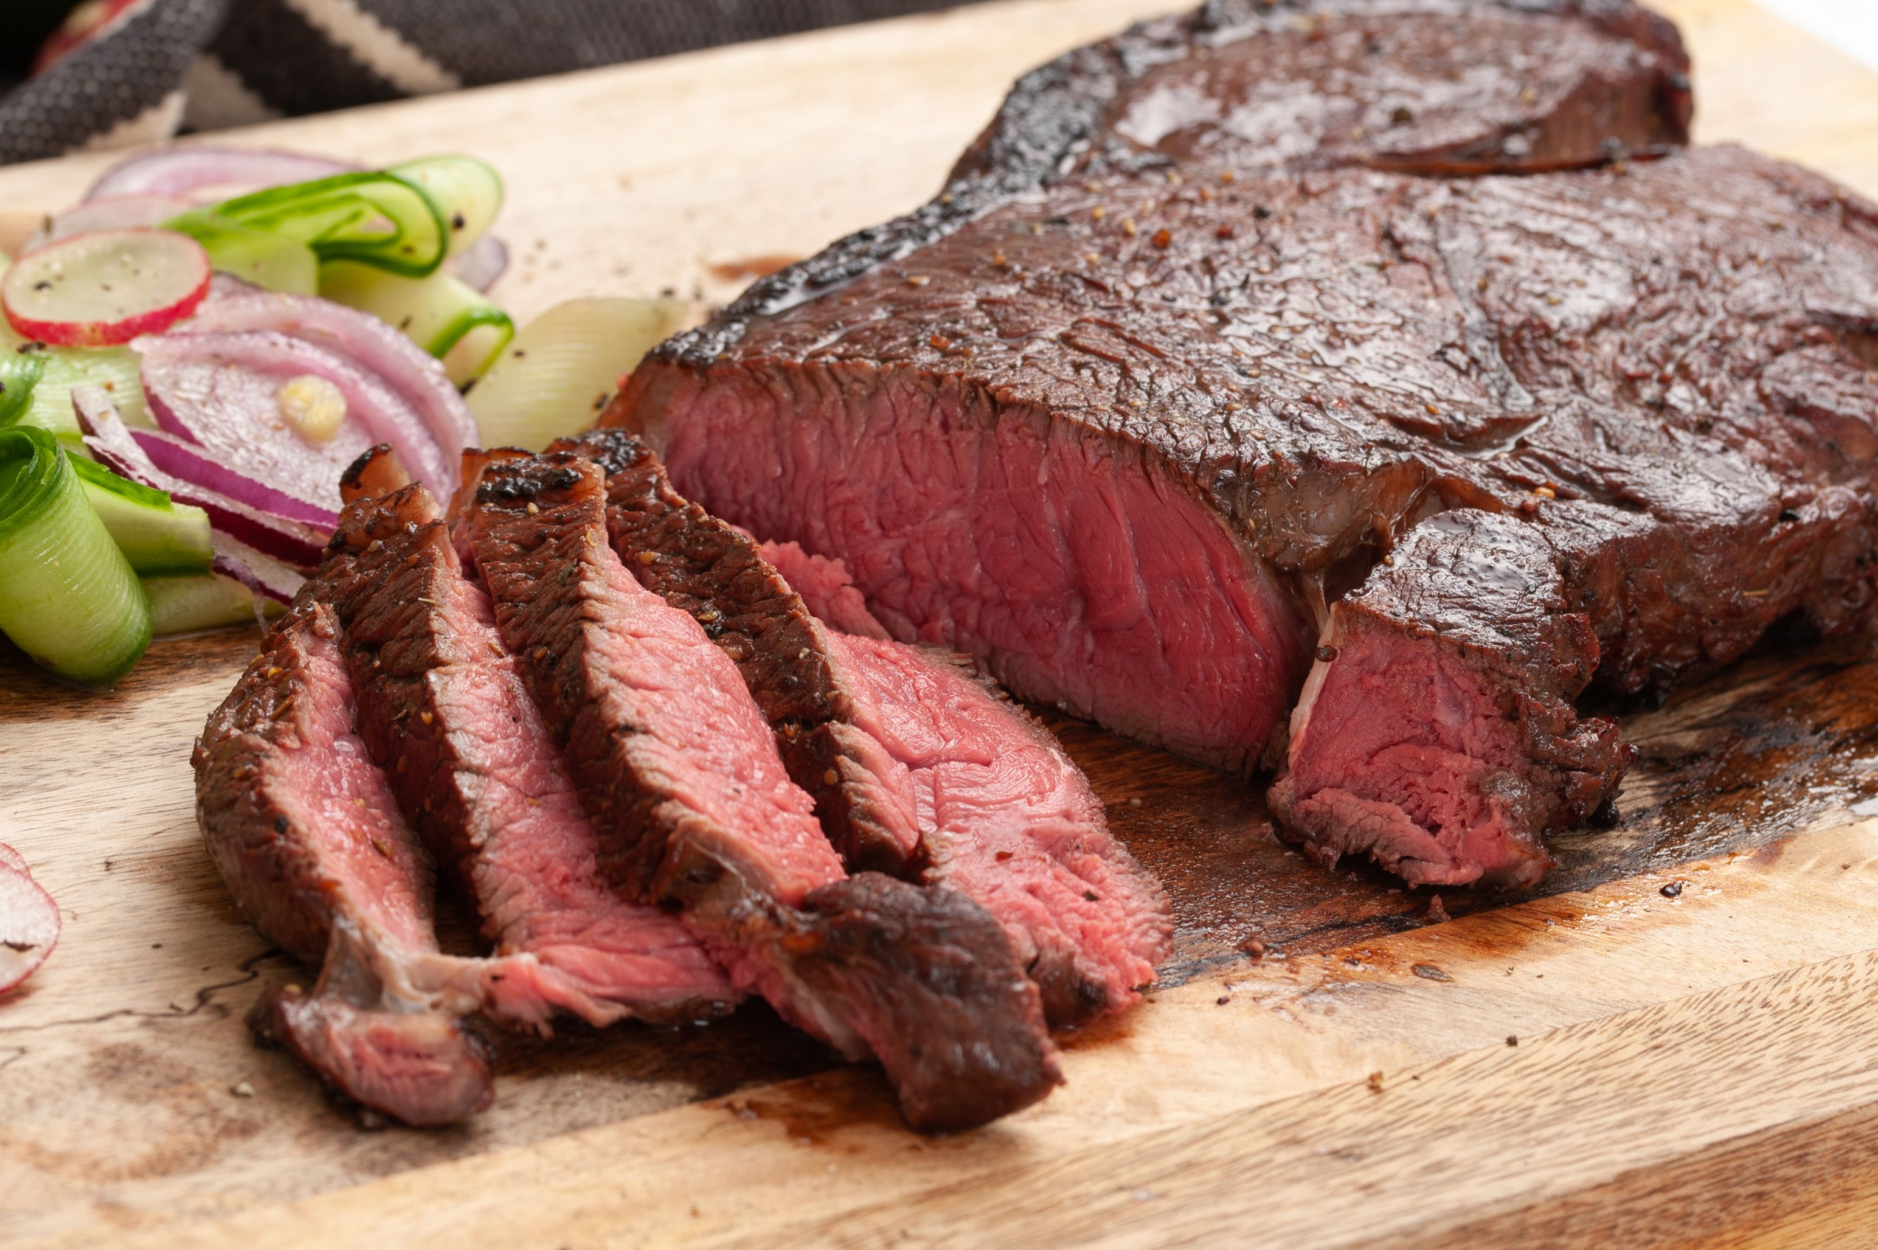
Wayne Untu

Slide 3
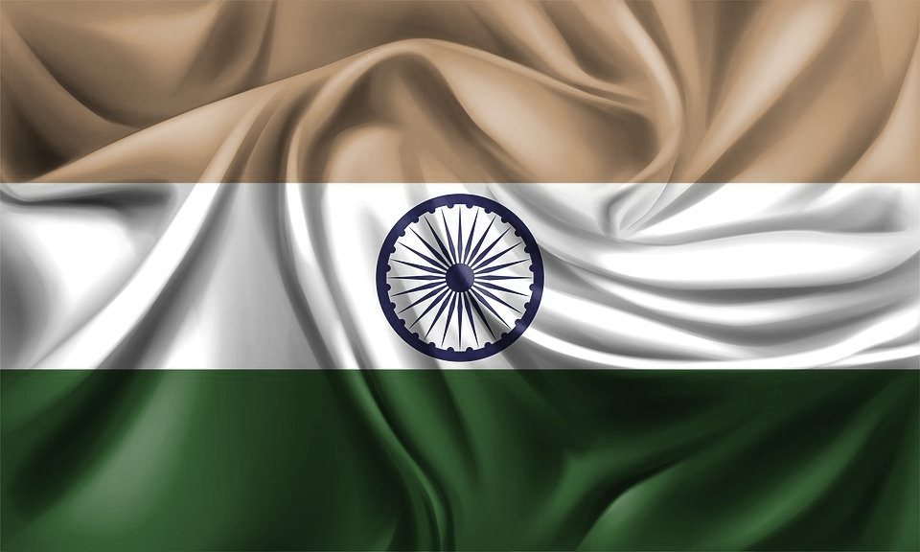
Research Background
Indian tourist in Indonesia increased by 52% from 2017 to 2018
Baliho “Wonderful Indonesia” was placed in Mumbai, 2019
Mumbai is city with the highest GDP in India = $310 Billion
Indonesian Ministry of Tourism → “After Coronavirus Pandemic is over, The opportunity in Tourism sector will jump up”

Slide 4
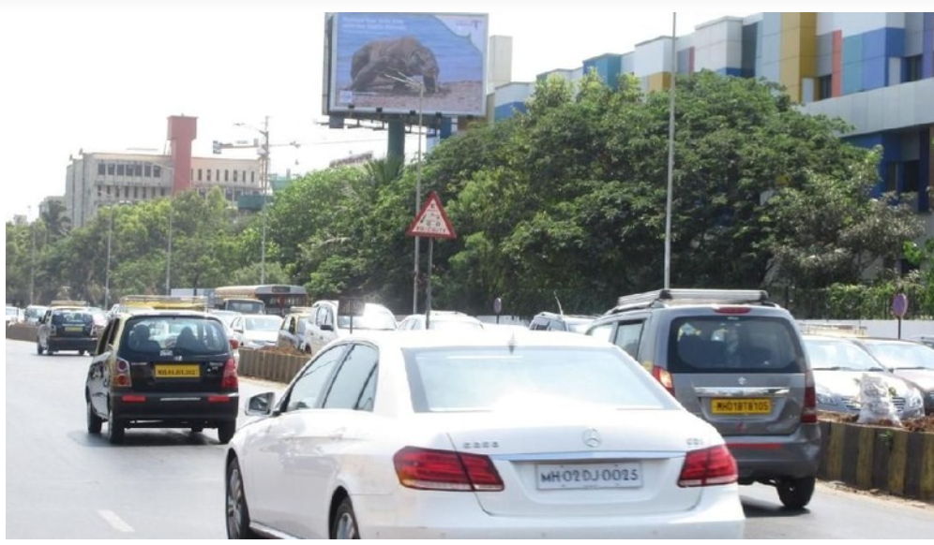

Slide 5
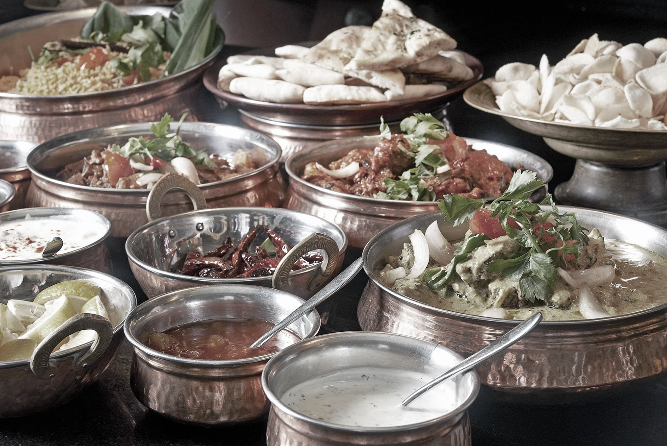



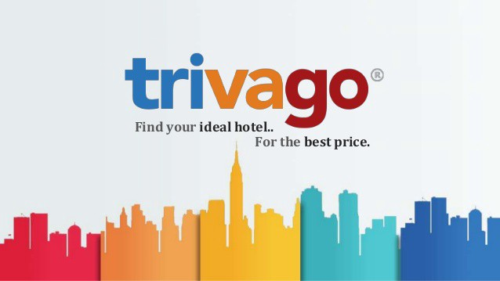
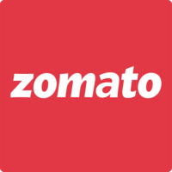
Solution

Slide 6
The Steps
1. Download Zomato Mumbai Restaurant Analysis Dataset from Kaggle: https://www.kaggle.com/srivpuneet16/zomato-mumbai-restaurant-analysis
2. Create recommendation system by using Content Based filtering
Because content based filtering could still be experienced by the user that have not rate any restaurant yet.
3. Create data gatherer system
Once the recommendation system is done, create a data gatherer system to work to gather more data information
4. Make a cooperation with Travel apps
Target all Indian tourist who has bought the ticket to Indonesia, so they could fill the survey. Furthermore, it could also be utilized for advertising

Slide 7
Bibliography
Indian tourist in Indonesia increased by 52% from 2017 to 2018
http://www.balipost.com/news/2018/04/04/41910/Tumbuh-Signifikan,Turis-India-Meningkat...html
Baliho “Wonderful Indonesia” was placed in Mumbai, 2019
https://travel.detik.com/travel-news/d-4568956/tarik-turis-india-sejumlah-baliho-wonderful-indonesia-dipasang-di-mumbai
Mumbai is city with the highest GDP in India = $310 Billion
https://traveltriangle.com/blog/richest-cities-in-india/
Indonesian Ministry of Tourism → “After Coronavirus Pandemic is over, There opportunity in Tourism factor will jump up”
https://bisnis.tempo.co/read/1336455/wishnutama-minta-sektor-pariwisata-siapkan-diri-pasca-corona

Slide 8
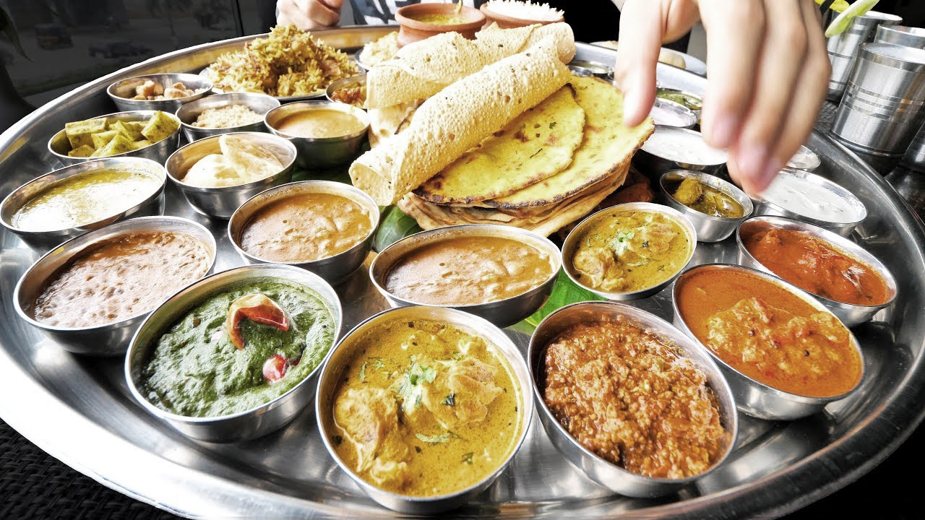
THANK YOU!
(धन्यवाद)

